Slide 1
Computer Vision
Lecture 4
Simon McLoughlin

Slide 2
Overview
Motion
Background Subtraction
Tracking
Optical Flow

Slide 3
Motion in Video
Motion is another cue that can be used in video as part of the segmentation process.
Groups of pixels moving in the same direction will generally belong to the same object so if we can identify how pixels are moving (their optical flow) then we can use it to segment images
There are lots of techniques that can be used to identify motion in the image. Lets start with the simplest one, background subtraction!

Slide 4
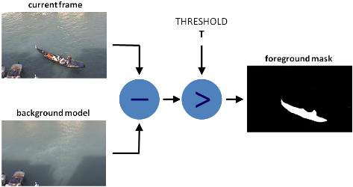
Background Subtraction
Background subtraction (BS) is a common and widely used technique for generating a foreground mask (namely, a binary image containing the pixels belonging to moving objects in the scene) by using static cameras.
BS calculates the foreground mask by performing a subtraction between the current frame and a background model, containing the static part of the scene or, more in general, everything that can be considered as background given the characteristics of the observed scene

Slide 5
Background Subtraction
Background Subtraction is widely used:
Traffic monitoring (counting vehicles, detecting & tracking vehicles)
Human action recognition (run, walk, jump, squat, . . .)
Human-computer interaction (“human interface”)
Object tracking!
Surveillance

Slide 6
Background Modelling
Background modelling consists of two main steps:
1. Background Initialisation
2. Background Update
In the first step, an initial model of the background is computed, while in the second step that model is updated in order to adapt to possible changes in the scene (e.g. illumination changes)
Robust maintenance of the background model should be able to handle lighting changes, repetitive motions from clutter and long-term scene changes

Slide 7
Background Modelling – Naïve Approach
Consider images now as a function of three variable I(x,y,t) where t is time (or frame number). A simple (but naïve) approach would be to initialise the background to the image at time t=0 and not update it!
Where would this work? In very controlled environments (indoor) where the background doesn’t really change.
For more complex environments (e.g. outdoor) we should update the background regularly to reflect more what the current background is like – How might we do this?

Slide 8

Background Modelling – Frame Differencing
If we use simple frame differencing the background is estimated to be the previous frame. The background subtraction equation then becomes (Th is a threshold):
The success of this approach will depend on a number of factors such as the speed of the foreground object (faster is better), the frame rate, the threshold used etc.

Slide 9
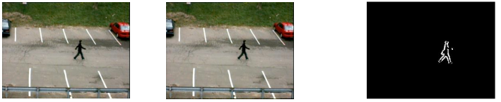
Background Modelling – Frame Differencing
You can see here that there is very little movement between the current frame and background. As a result you get a leading and trailing edge in the thresholded image but not a full silhouette
What about if we used I(x,y,t-N) where we can change N?
> TH
I(x,y,t)
I(x,y,t-1)

Slide 10
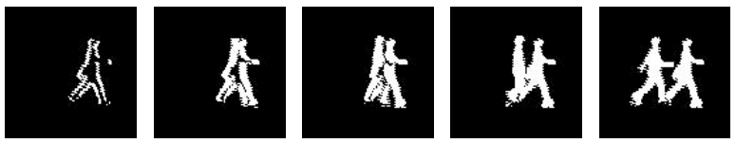
Background Modelling – Frame Differencing
N=1 N=3 N=5 N=9 N=15
As we delay the background frame more and more we get a more complete silhouette but we also notice that we get two, one where the object is now and one where is was at time t-N
If the application allows we could combine the frames at t-N and t+N using a logical AND to remove the double but the processing would be delayed by N frames which may or may not be a problem

Slide 11
Background Modelling – A mean filter
A problem that might arise with simple frame differencing is that of noise and slight background motion e.g. things (e.g. trees) blowing in the wind, waves, abrupt lighting changes etc.
One simple approach to reducing some of these issues is to use the average of the frames in the last T seconds as the background image. So if T=2 and the frame rate was 10 fps you would be averaging the last 20 frames as the background model (2 seconds of video).
This way you will reduce (not eliminate) the effect of the repetitive background motions such as trees, waves, rain etc. such that they might fall below the binarisation threshold.

Slide 12
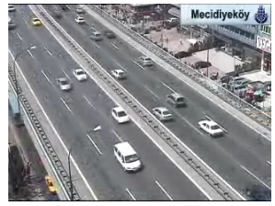
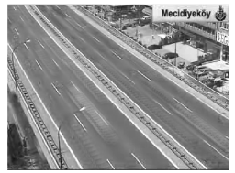
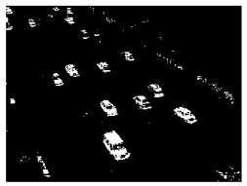

Background Modelling – A mean filter
I(x,y,t) Thresholded Image
For n=20

Slide 13
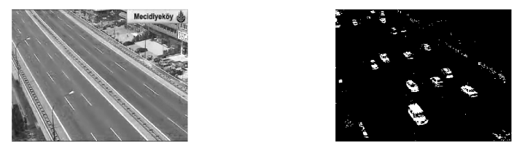
Background Modelling – A median filter
Using a median filter is similar to a mean filter but can yield better results. We assume that the true background pixel value occurs most of the time! – Could also use the mode (most common value).
Median filter, n=20
Thresholded image

Slide 14
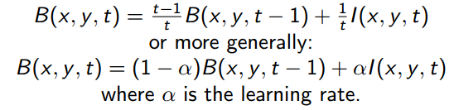
Background Modelling – So far
The approaches we just looked at have advantages and disadvantages:
Pros: Easy to implement, pretty fast, background model changes with time
In particular for a mean background model we can use a running average to speed things up (note we can use a fixed alpha value for a time weighted sum which will place more weight on the most recent images):
Cons:
Not best approach for multi-modal backgrounds
There is one global threshold for all pixels in the image which is not a function of time

Slide 15
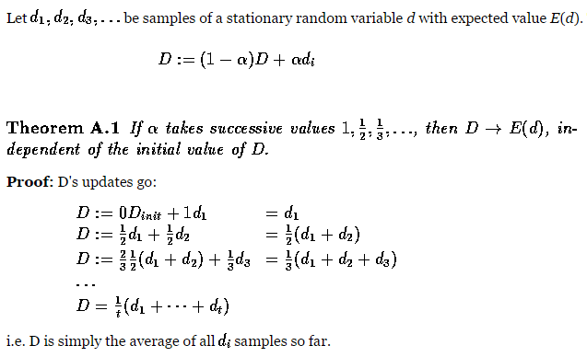
Background Modelling – Running Average

Slide 16
Background Modelling – Selectivity
For each frame, every pixel is classified as foreground or background. We can propagate this information into the background model
If a pixel is classified as foreground, it is ignored in the background model update, i.e. we only use background pixels at time t-1 to update the model at time t.
Running Average with Selectivity:
IF I(x,y,t-1) is background
IF I(x,y,t-1) is foreground

Slide 17
Background Modelling – Running Gaussian Average
With this approach we think of the intensities a pixels takes over time in the background model as a probability density function, i.e. a histogram in the discrete case (more specifically a Gaussian one).
To maintain the background model we need two parameters for each pixel, the mean and the standard deviation (with these we can define a Gaussian)
Then when we get a pixel value in the current image, I(x,y,t), we can determine a probability that it is part of the background from the background Gaussian (low probability means a foreground object).
We can use some multiple (k) of the standard deviation as the threshold for a finding a foreground object in the subtracted image.

Slide 18

Background Modelling – Running Gaussian Average
We maintain a running average image as before:
But we also maintain a variance image :
And then our foreground condition becomes
So threshold is not fixed but main problem with this approach is that it assumes the background PDF can be represented with a single Gaussian but it could be multi-modal

Slide 19
Background Modelling – Gaussian Mixture Models
Previous methods don’t deal very well with multi-modal background pixels. These are background areas that periodically take one of a number of values (e.g. waves, trees etc.)
To deal with this Stauffer & Grimson (2000) introduced a popular technique based on modelling background pixels using a number of Gaussians (3-5), hence the name.
The basic idea is that we have a background model represented by a number of WEIGHTED Gaussian distributions where the weights are determined from the historical model pixels (distributions that occurred more frequently will have higher weights)
For each new pixel then we check how close it is to one of our Gaussian distributions. If it is close (within 2.5 standard deviations) then we classify it as being part of that distribution.
If it is not close to any distribution then we start a new one.

Slide 20
Background Modelling – Gaussian Mixture Models
To make the background/foreground classification then we look at the distributions and in particular the one we classified the pixel belonging to. We set a background threshold (e.g. 70%) which is the minimum number of pixels (over time) that should be background and we choose the Gaussians with the highest weights that will exceed our threshold.
If the pixel belongs to one of these distributions then it is a background pixel, otherwise it is a foreground pixel. Naturally as we iterate through the frames we will have to drop the distributions with the lowest weights to maintain the max number that was set at the beginning, N=3-5.
We must of course update our distributions for the next iteration. This involves updating the weights and the Gaussian parameters (mean and standard deviation)
Most of the better background subtraction techniques are based around this one and the one in openCV implements this approach and also some variations on it.

Slide 21
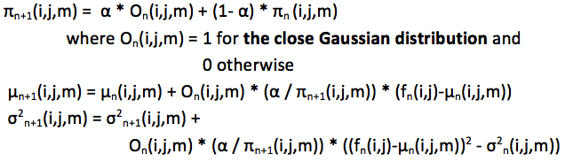
Background Modelling – Gaussian Mixture Models
We won’t go into the Mathematics on it too much but they are similar to the Gaussian running average except you have another variable for the Gaussian distributions and an update equation for the weights (as well as the Gaussian parameters (mean and standard deviation)).

Slide 22
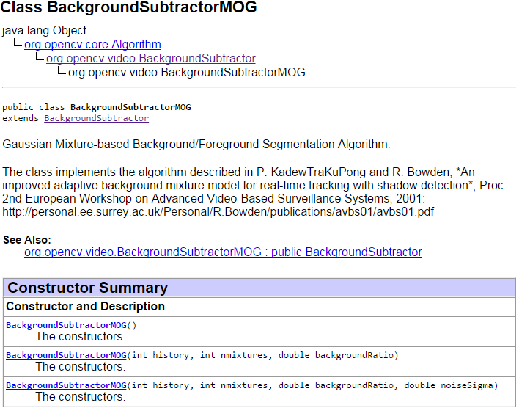
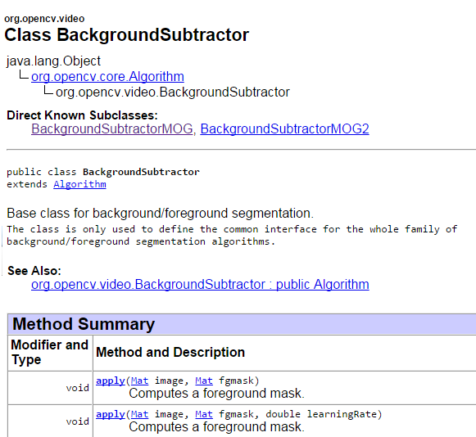
Background Subtraction – openCV – Mixture of Gaussians

Slide 23
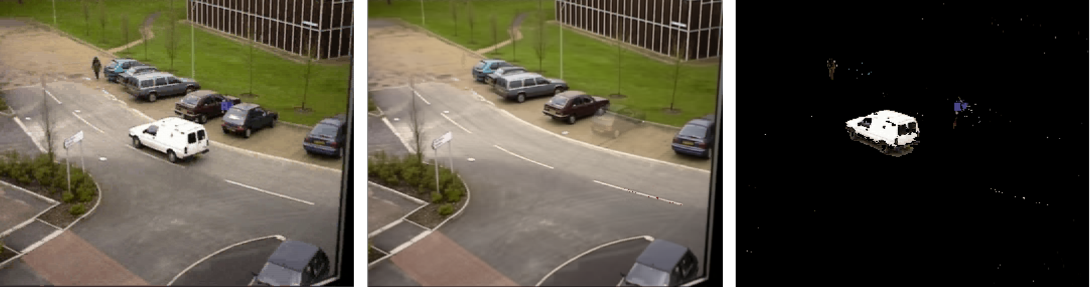
Background Subtraction – openCV – Mixture of Gaussians
© Reproduced by permission of Dr. James Ferryman, University of Reading

Slide 24
Motion - Tracking
Frequently we want to track an object in an image sequence, e.g. track a sports person to analyse their statistics, track an object for obstacle avoidance etc.
Tracking starts with a basic assumption that we have detected an object (at time t=0) and we now want to follow or track where it goes
We could of course reapply our detection process every frame to try and track the object this way but this is normally less robust and more computationally expensive than switching to a tracking algorithm once an initial fix is determined.
If you lose track of the object you can switch back to detection mode

Slide 25
Motion - Tracking
Tracking can be difficult for a number of reasons:
The motion of the object may be complex
The camera itself may be moving
The object may change shape (non-rigid objects)
The object may be fully or partially occluded at time (sports footage)
Changing illumination conditions
Like most areas of Computer Vision (tracking is only one) there are a number of possible approaches/techniques that could be taken depending on the requirements of the application
We will look at Mean Shift, CAMShift and Optical flow

Slide 26
Tracking – Mean Shift
Mean Shift is a relatively straightforward approach to tracking that makes use of the histogram of the detected object
The basic idea is that we compute the histogram of the detected object, then in the next frame we define a region of interest (ROI) around the centroid of the object and for each pixel in the ROI we lookup its probability in our object histogram – this gives a spatial representation of the likelihood of the object colours/intensities (a confidence map)
We then simply calculate the weighted (by the probabilities) centroid of all the points in our ROI and move the centre of our ROI to here and repeat the process until the movement converges – this is hill climbing or gradient ascent where we continually choose the maximum value until we plateau!

Slide 27
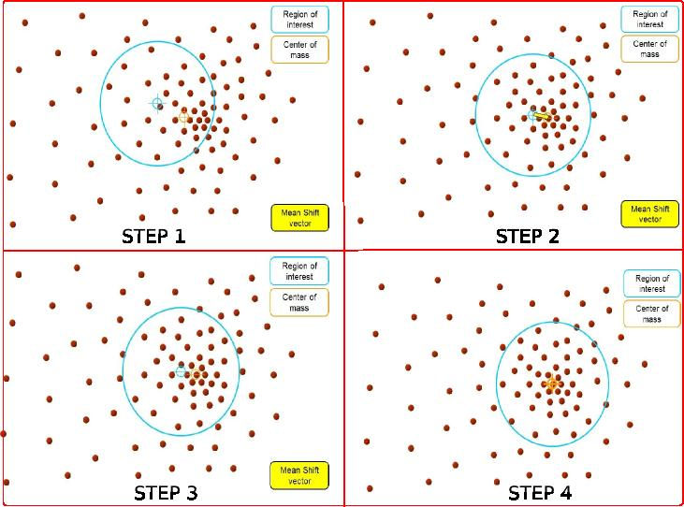
Tracking – Mean Shift

Slide 28
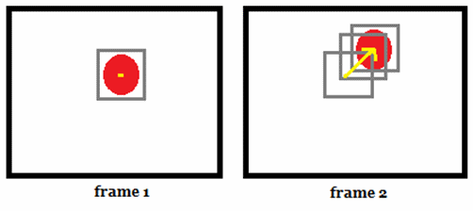
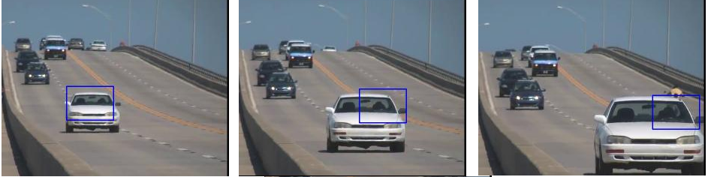
Tracking – Mean Shift

Slide 29
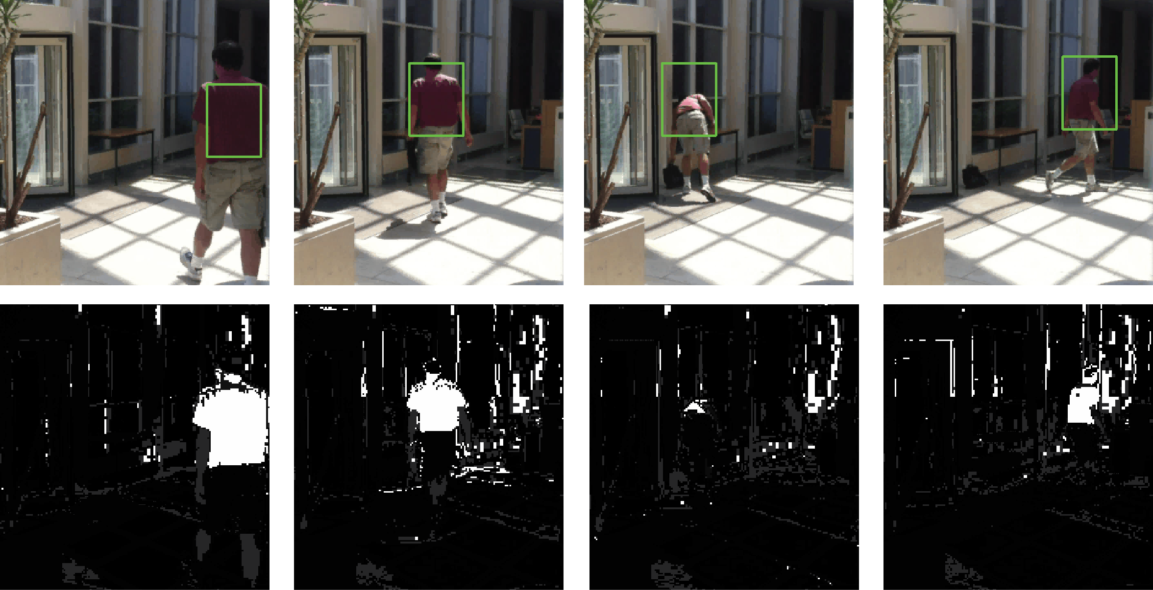
Tracking – Mean Shift

Slide 30
Mean Shift – Kernel Based
The mean shift algorithm we just mentioned does not weight the initial model/object histogram – i.e. all pixels are considered equal but frequently the object to be tracked is in the middle of the initial bounding box ROI and the background is at the edges – clearly we would like to place more weight on the object pixels
To deal with this we can apply a spatial weighting function (a kernel) to the model histogram where we have higher weights for the intensities in the middle of the ROI and lower weights for the intensities at the edges – you guessed it, a Gaussian Kernel!

Slide 31
Tracking - CAMShift
Notice when tracking the car on the previous slide how a different part of the car was found as it moved closer to the camera. This is undesirable as it increases the chances of losing track and is a consequence of using a fixed window size and orientation
A better solution, CAMShift (Continuously Adaptive Mean Shift) adapts the window size and orientation as it repeatedly finds the target. The main premise for adapting the size is by looking at the area of the PDF (histogram).
If an object gets closer the area of the PDF should go up as more of the object intensities/colours will occupy the ROI whereas the opposite is true as the object moves away
So CAMShift applies mean shift first then alters the ROI window size based on the PDF area.
To find the orientation we can do some thresholding of the confidence map to identify the pixels to be used in the orientation computation.

Slide 32
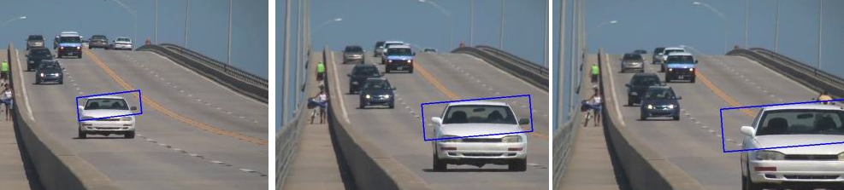
Tracking - CAMShift

Slide 33
Motion Analysis – Optical Flow
We can compute a motion field for every pixel in the image, which is called dense optical flow, i.e. we are calculating where each pixel moves to (magnitude and direction) as we go from frame t to frame t+1
We can use the optical flow to do a variety of tasks on the image.
We can segment the image based on the different motion fields
We can track objects by analysing the direction they are travelling and predict their position in later frames
We could recognise objects based on their motion pattern
We could identify suspicious motion patterns etc.

Slide 34
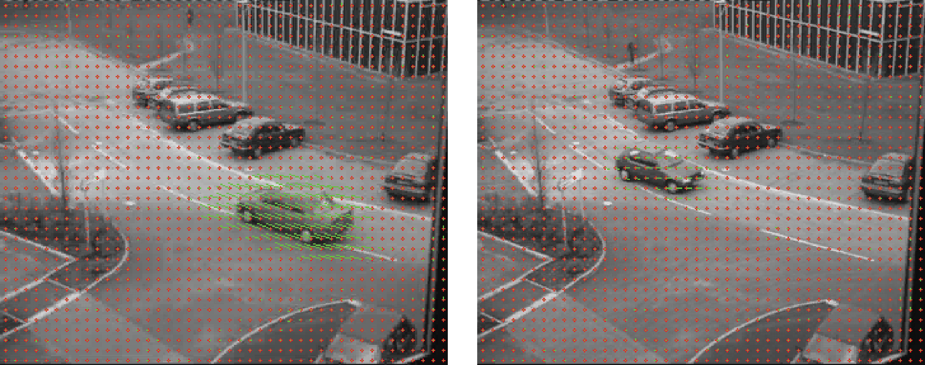
Motion Analysis – Optical Flow
© Reproduced by permission of Dr. James Ferryman, University of Reading

Slide 35
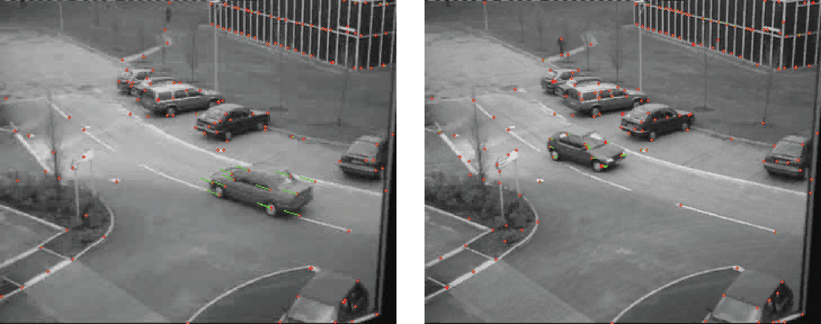
Motion Analysis – Optical Flow
We cannot accurately compute optical flow for constant regions or along edges. Often better to compute optical flow just for features… (e.g. Lucas Kanade feature tracker in openCV)…

